Slide 1
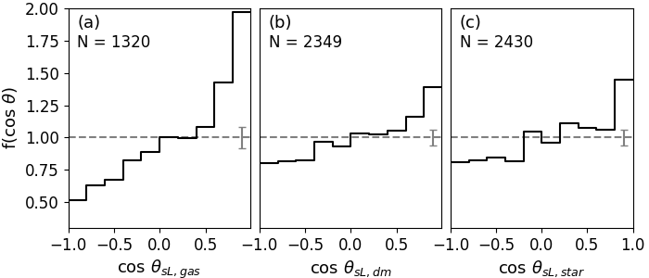
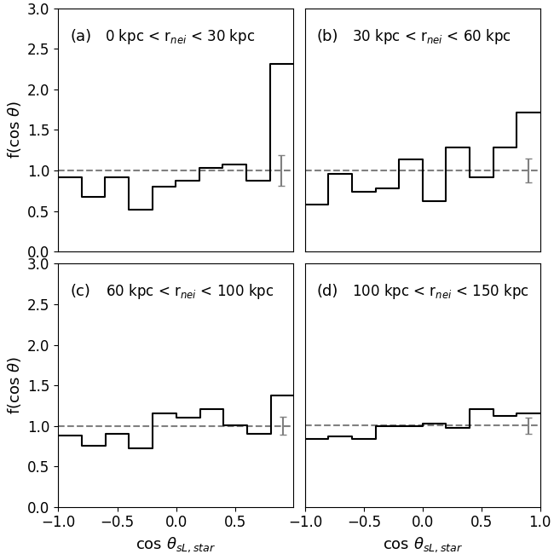
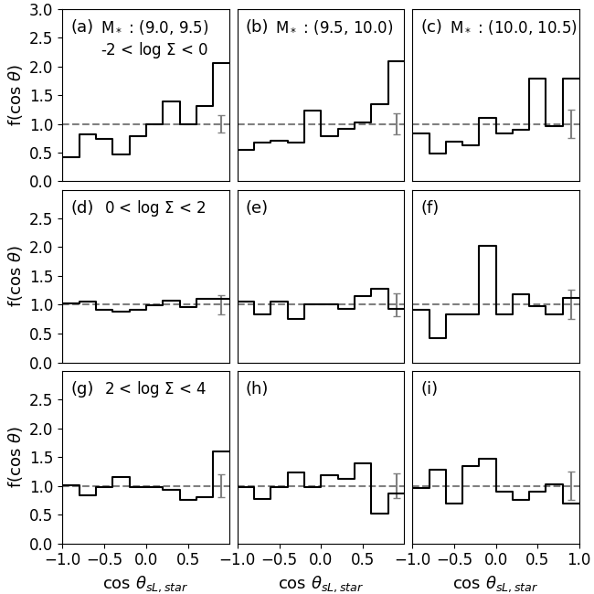
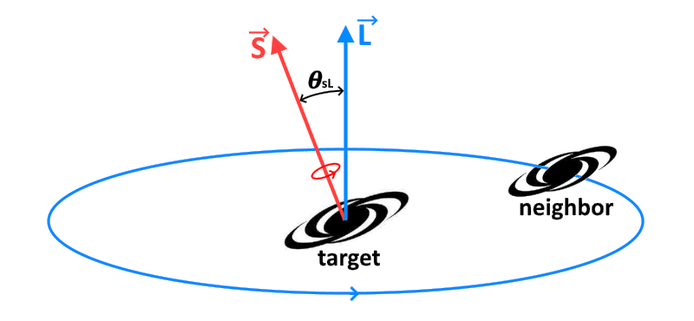
On the origin of the spin–orbit alignment in galaxy pairs
Jun-Sung Moon, Sung-Ho An, Suk-Jin Yoon
Department of Astronomy & Center for Galaxy Evolution Research, Yonsei University; moonjs@yonsei.ac.kr
I. Methodology
II. Spin–Orbit Alignment at z = 0
The spin–orbit alignment is found in all components (gas, DM, star), i.e., galaxy pairs at z = 0 are prograde.
The alignment is much stronger for closer pairs in lower-density environments.
- Paired Galaxy Sample
We select paired galaxies from a cosmological hydrodynamic simulation, the IllustrisTNG (Nelson et al. 2019) – TNG100.
Galaxies (M_{*,tgt} > 10⁹ h⁻¹M_{sun}) that have a neighbor with log(M_{*,nei} / M_{*,tgt}) < 1.0 within 150 kpc at z = 0 are analyzed.
A total of 2549 paired galaxies are included in the sample.
- Spin–Orbit Orientation ($θ_{sL}$)
We refer to the orientation with cos θ_{sL} > 0 as “prograde,” and the orientation with cos θ_{sL} < 0 as “retrograde.”

Slide 2
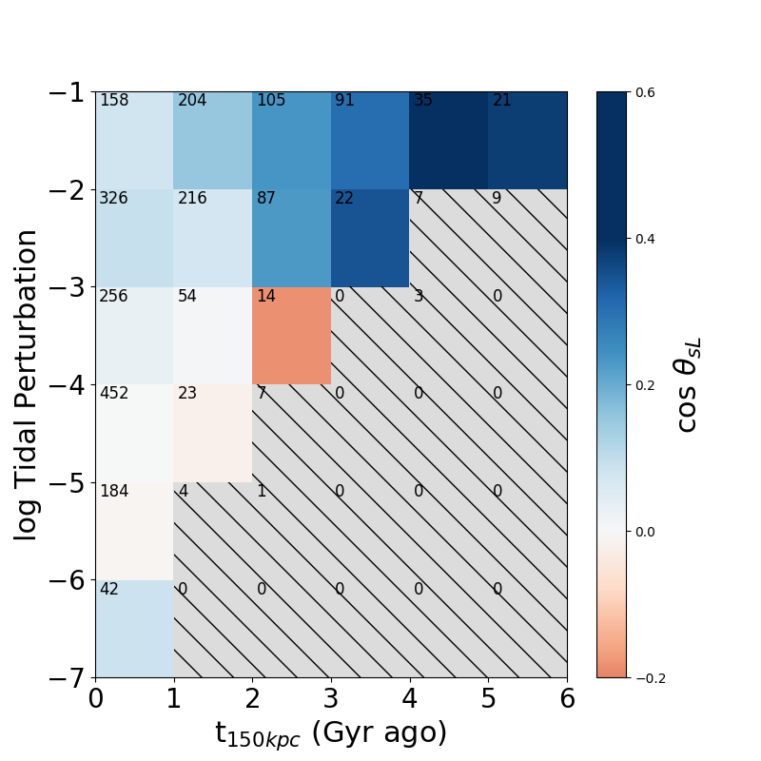
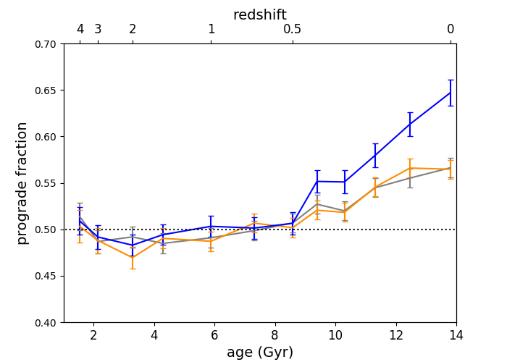
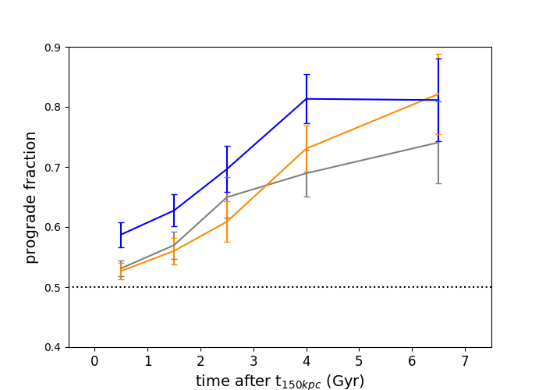
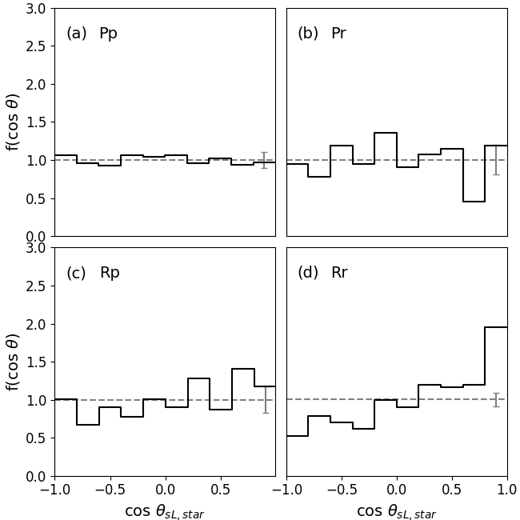
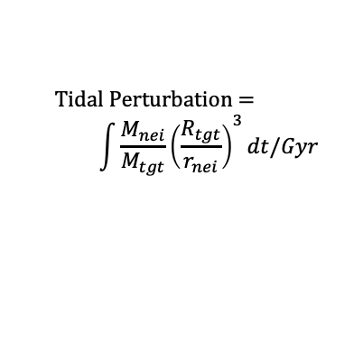
On the origin of the spin–orbit alignment in galaxy pairs
Jun-Sung Moon, Sung-Ho An, Suk-Jin Yoon
Department of Astronomy & Center for Galaxy Evolution Research, Yonsei University; moonjs@yonsei.ac.kr
III. Formation of the Spin–Orbit Alignment
IV. Tidal Perturbation
The fraction of prograde orientations (cos θ_{sL} > 0) for progenitors (along the MPB in SubLink) of paired galaxies at z = 0
The fraction of prograde orientations (cos θ_{sL} > 0) at z = 0 as a function of the interaction time (defined as the time after the distance between two galaxies becomes less than 150 kpc)
$$\text{Tidal} \text{Perturbation}\text{ =}$$
$$\int{\frac{M_{nei}}{M_{tgt}}{\left(\frac{R_{tgt}}{r_{nei}}\right)}^{3}dt/Gyr}$$
for z = 0 pairs
The orbit is more prograde as the tidal perturbation and the interaction time increase.
gas
gas
star
star
DM
DM
V. Hydrodynamic Effects
gas poor + gas poor
gas poor + gas rich
gas poor <= f_{gas} = M_{gas} / M_{star} = 0.3 => gas rich
Traced back in time, pairs selected at z = 0 were initially random in terms of the orientation before z = 0.5, and the alignment gets established later.
The fraction of prograde orientations increases as the interaction between two galaxies in a pair is longer.
Our results favor the scenario in which the spin–orbit alignment is originated from interactions with the neighbor.
The spin–orbit orientation strongly depends on the gas fraction of galaxies, and it is stronger for more gas-rich pairs.
gas rich + gas poor
gas rich + gas rich

